Slide 1
Heart Failure:
The heart is unable to pump blood at a rate that meets the requirements of metabolizing tissues. The failing heart cannot pump blood delivered to it by venous circulation. In adequate cardiac output always accompanied by increased congestion in the venous circulation.

Slide 2
Heart failure can affect left side, right side or both sides. The most common causes of left-sided heart failure are:
1- IHD 2- Systemic hypertension 3-Mitral or aortic valve disease, symptoms are related to pulmonary congestion and edema.

Slide 3
The most common causes of right sided heart failure is pulmonary hypertension associated to peripheral edema and visceral congestion especially liver producing congestive hepatomegaly which on cut section producing a pattern called nutmeg liver in which there is red congested nodules surrounded by pale areas at the periphery of the lobule.

Slide 4
Congenital Heart Disease
Are the most common forms of congenital anomalies, occur in about 8 in 1000 live birth. Genetic factors play an important role in some cases as in trisomies 13, 14, 18 and 21, while in others pure environmental factors play an important role such as congenital rubella infection. 90% of the cases the cause is unknown thought to be due to multifactorial inheritance.

Slide 5
Left-to-Right Shunts:
In which there is abnormal communication permitting blood to flow from left to right cardiac chambers. Cyanosis is a late sign. They include:
Atrial septal defect (ASD).

Slide 6
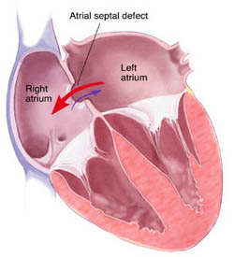

Slide 7
Ventricular septal defect (VSD).

Slide 8
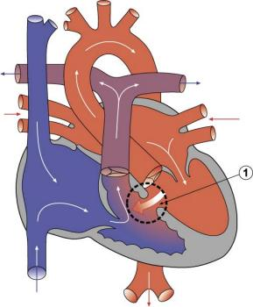

Slide 9
Patent (persistent) ductus arteriosus (PDS). The ductus arteriosus is an arterial channel communicating between pulmonary artery and aorta during intrauterine life; it will close shortly after birth

Slide 10
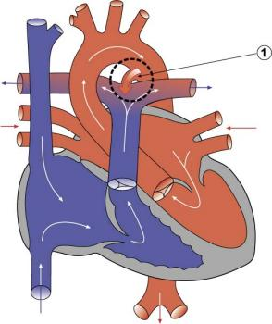

Slide 11
Right-to-left shunts:
In which there is abnormal communication permitting blood to flow from right to left cardiac chambers. Cyanosis is an early sign. They include:

Slide 12
Tetralogy of Fallot: It is the most common cause of cyanotic congenital heart disease, it includes VSD, aortic root overrides the VSD, right ventricular outflow obstruction and right ventricular hypertrophy.

Slide 13
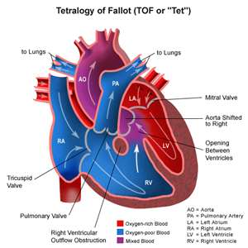

Slide 14
Transposition of the great arteries in which the aorta arises from right ventricle and the pulmonary artery arises from the left ventricle

Slide 15
Myocardial Diseases
Myocarditis:
Is a group of inflammatory processes of the myocardium that results in injury to the cardiac myocytes. It may be primary or secondary to other pathology. The major causes of primary Myocarditis are viral, bacterial and immune-mediated reaction like systemic lupus erythematosus, microscopically the myocardium shows edema and infiltration by lymphocytes.

Slide 16
Pericardial Diseases:
Pericarditis:
Viral infection is responsible for most of cases. Uremia is the most common systemic disorder associated with Pericarditis.

Slide 17
Morphology:
In uremic Pericarditis the exudate tend to be fibrinous (Butter and bread appearance), in bacterial Pericarditis the exudate tend to be fibropurulent.
In chronic Pericarditis the appearance varies from delicate adhesions to dense fibrotic adhesion preventing the heart from normal expansion (constrictive Pericarditis).

Slide 18
Pericardial effusion: Is accumulation of fluid in the pericardial space, caused by:
- Serous effusion caused by congestive heart failure, hypoalbominemia
- Serosanguinous caused by chest trauma, and malignancy.
- Chylous caused by mediastinal lymphatic obstruction.

Slide 19
Hemopericardium:
Is accumulation of pure blood in the pericardial sac caused by ruptured aortic aneurysm, ruptured myocardial infarct and penetrating trauma to the chest. If rapidly accumulate in pericardial sac it will cause cardiac temponade and death.

